Slide 1



Slide 2
Agenda
Intro to Machine Learning (ML)
Classification AND Regression
Common Terms
Demo1
R-CNN, Fast R-CNN AND Faster R-CNN
You Only Look Once (YOLO)
Demo2

Slide 3
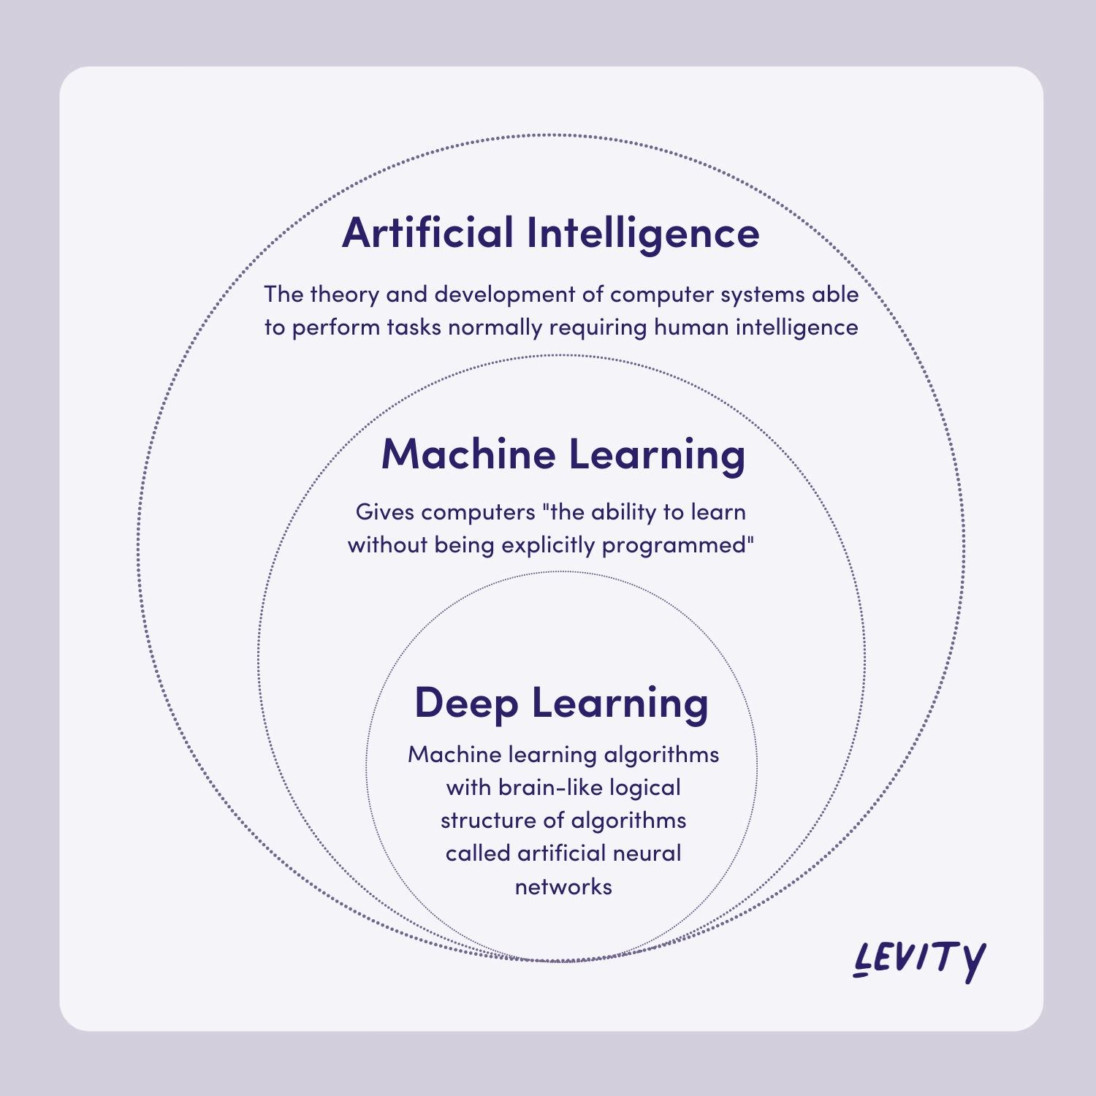
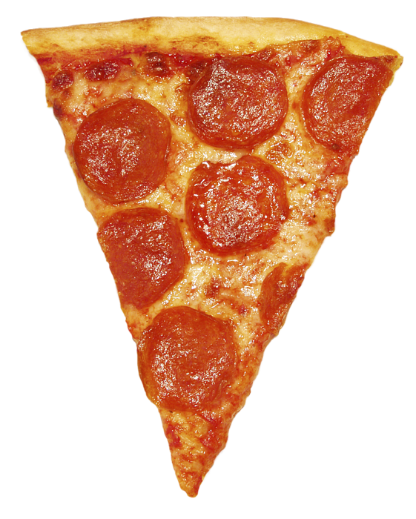
What is machine learning ?
Time | Healthy | Save Money
1 | 0 | 1
W = 5 | W = 3 | W = 2
Do you love Pizza ?
Y = (1 x 5) + (0 x 3) + (1 x 2) – 5 = +2
We Will Order !
Notes:
AI -> ML -> NN [Backbone of Deep Learning]

Slide 4
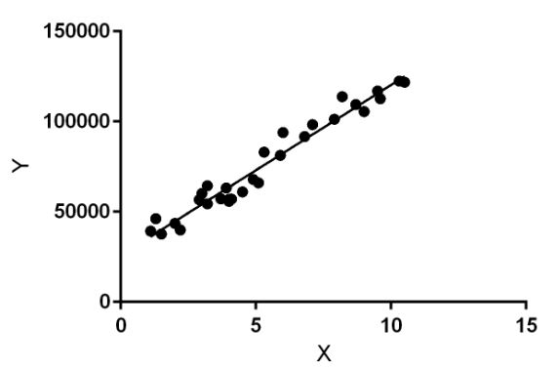
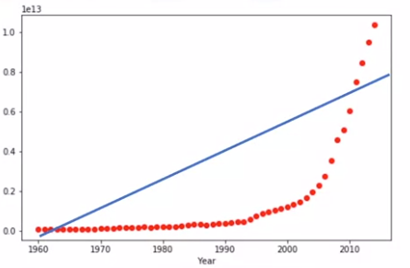
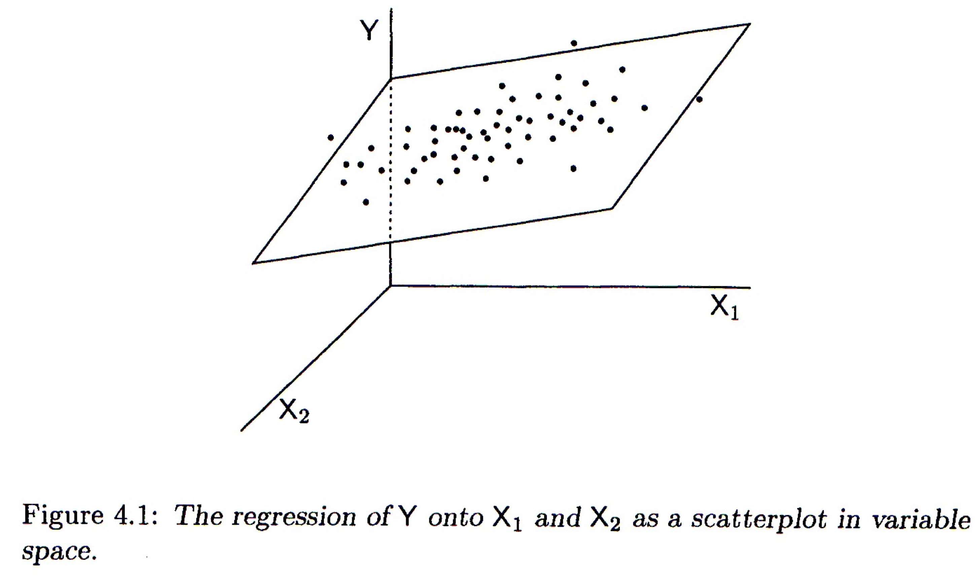
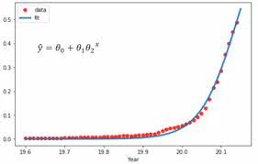
Regression
VS. Classification
1. Linear Regression
2. Multiple Regression
3. Non-Linear Regression
Notes:
AI -> ML -> NN [Backbone of Deep Learning]

Slide 5
Classification
Multi-Class Classification using
SVM
“Support vector machine”
Binary Classification using
Logistic Regression

Slide 6

Classification
What about a small challenge …
Cat Fish
Dog Shark
C1 C2
Classification VS. Clustering

Slide 7
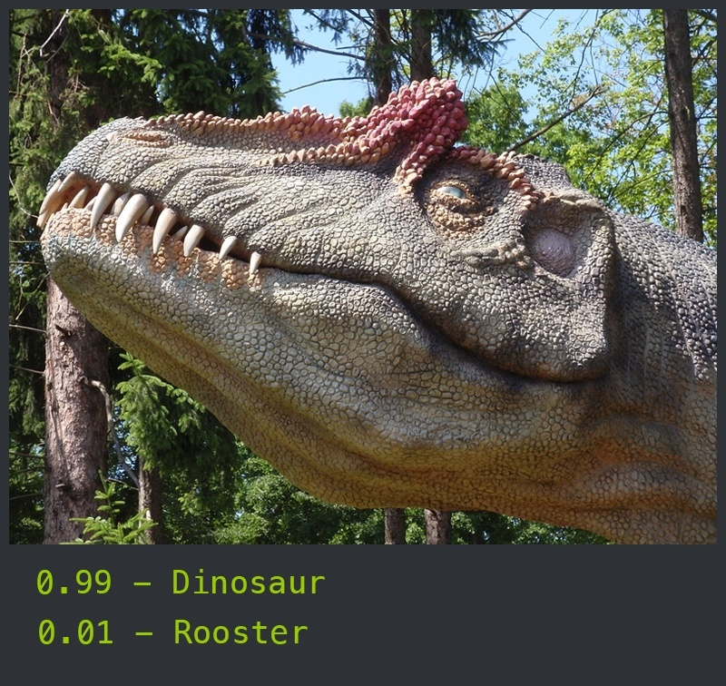
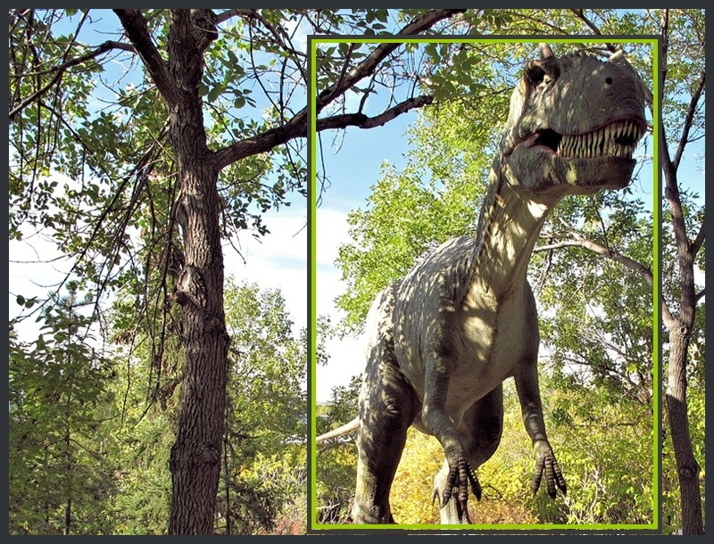
Classification
What about a small challenge …
Classification VS. Localization

Slide 8

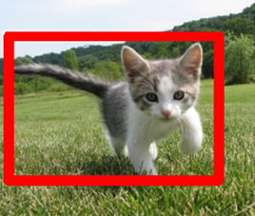
Classification
What about a small challenge …
Classification VS. Segmentation

Slide 9
Common Terms
1. Weights
5. Pre-processing
2. Loss Function
6. Neuron
3. Cost Function
7. Data Augmentation
4. Overfitting VS. Underfitting
8. NLP

Slide 10
[Demo]
Binary Classification

Slide 11
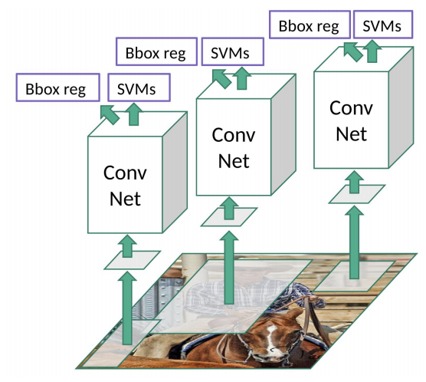
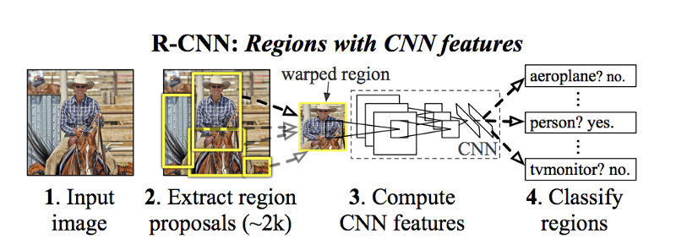
Object detection
R-CNN
(47 seconds)

Slide 12
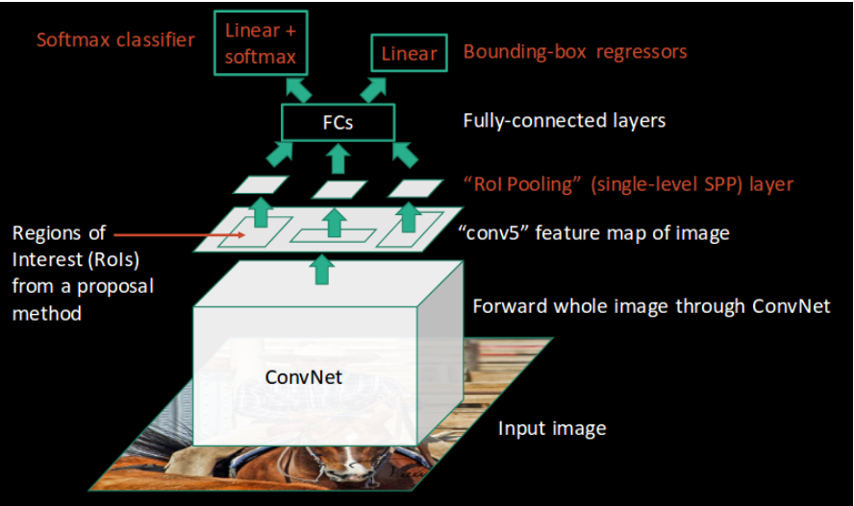
Object detection
Fast R-CNN
(2.3 seconds)

Slide 13
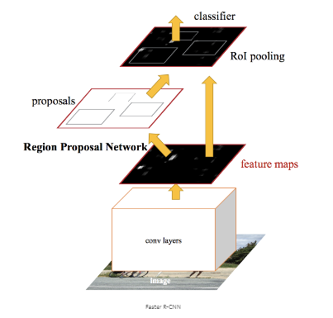
Object detection
Faster R-CNN
(0.2 seconds)

Slide 14
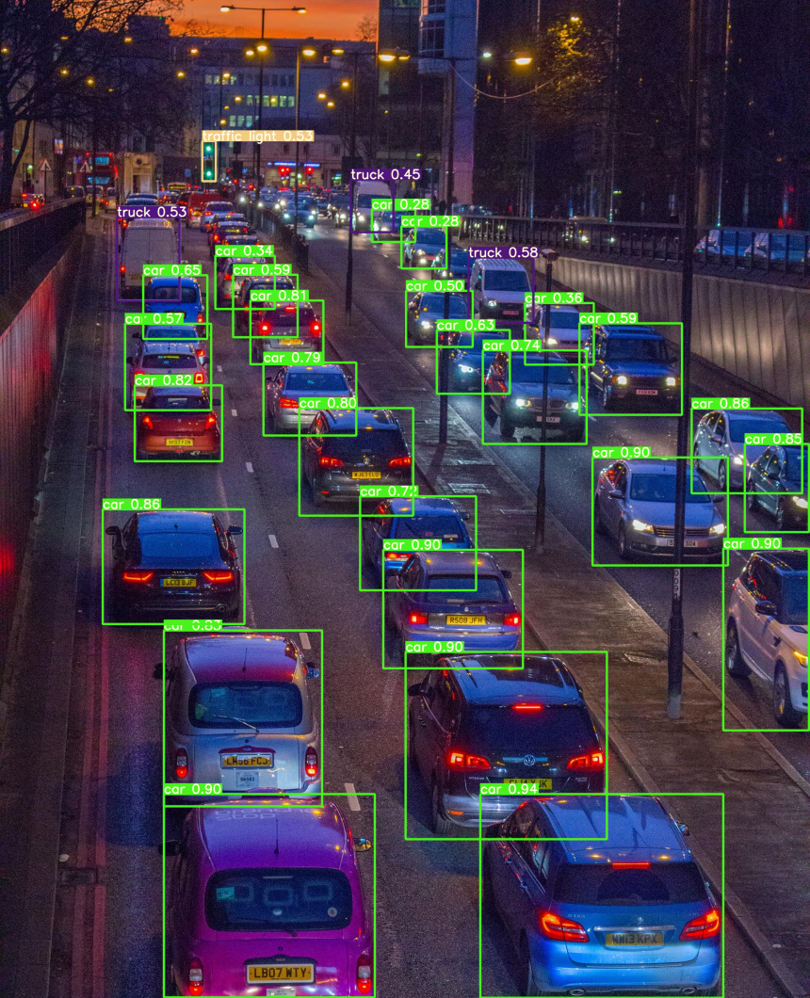
Object detection
YOLOv7
(155 FPS)

Slide 15
Any
Questions ?

